Slide 1
Agero

Slide 3
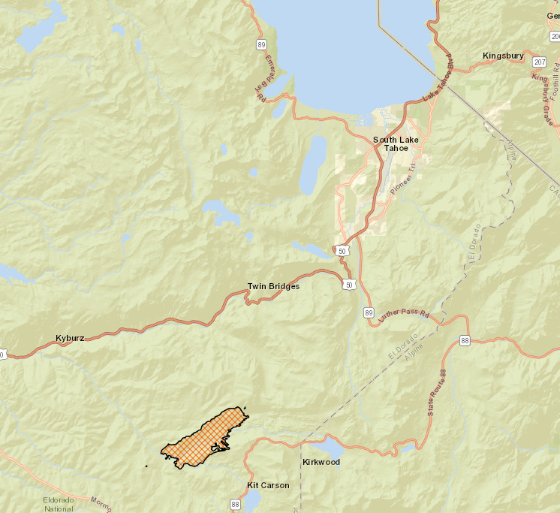
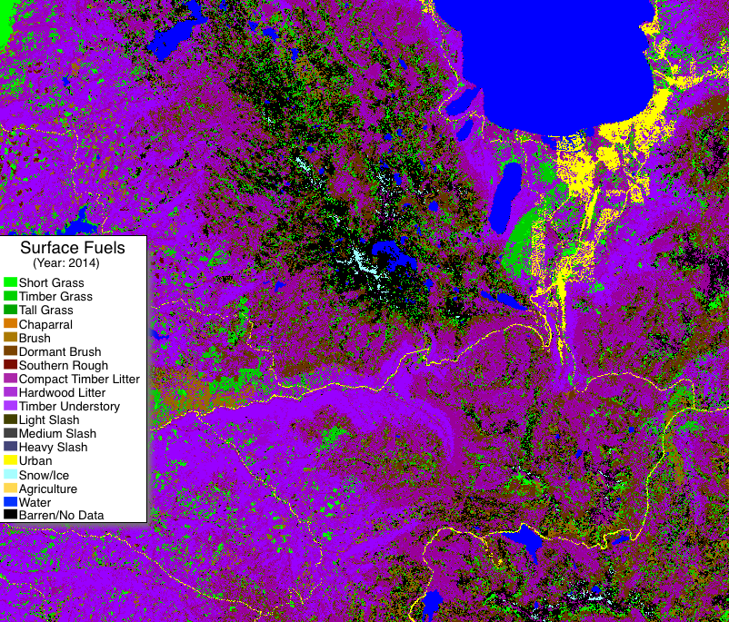
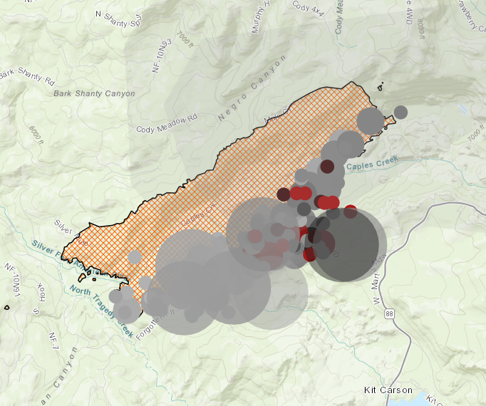
Propagation – How Fires Spread
There are many, many, many, many variables…
Let’s look at two ways that fires can spread
Radiated (radiation) heat raising temperatures to ignition point

Slide 4
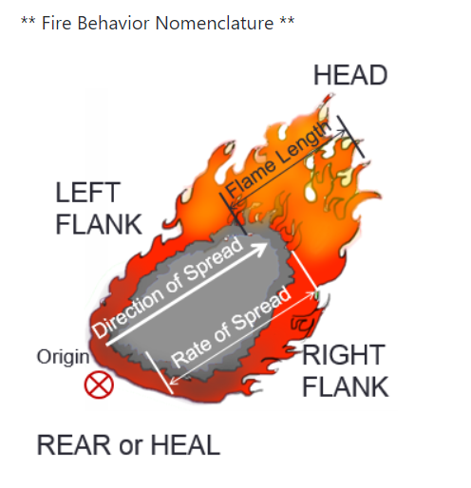
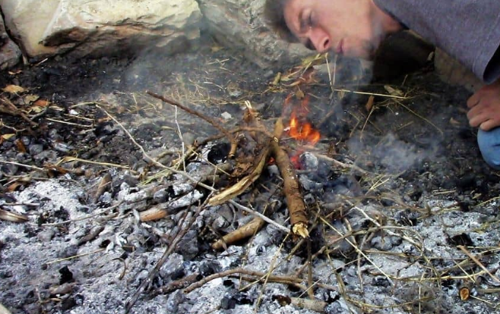
Propagation – How Fires Spread (cont.)
Wind matters too, right?
Yes, but…..is it helping or hurting?

Slide 5
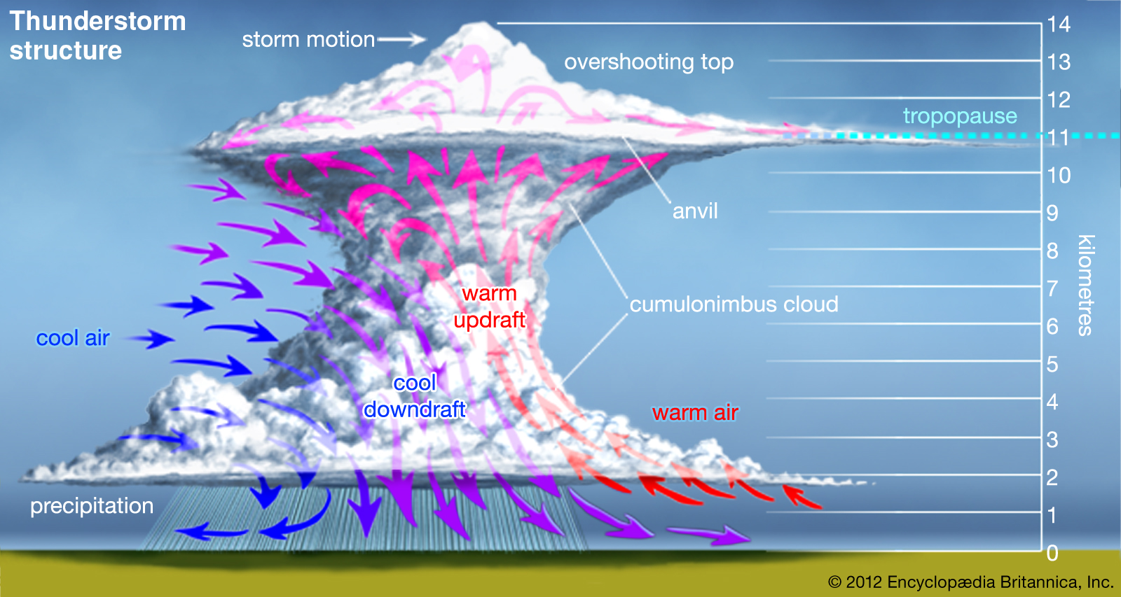
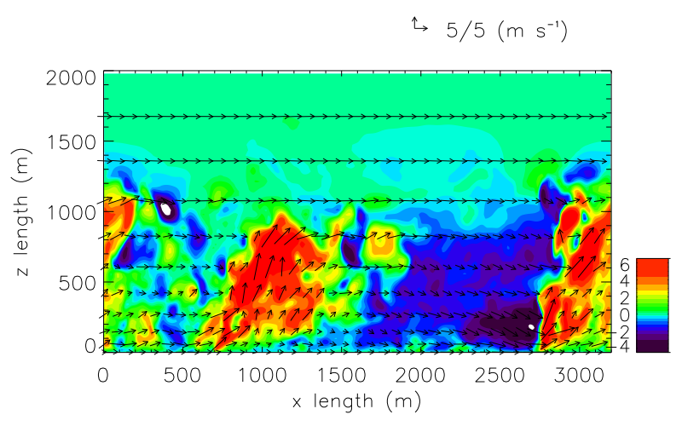
Which Winds?
Like a thunderstorm…
…but it’s on fire!!!

Slide 6
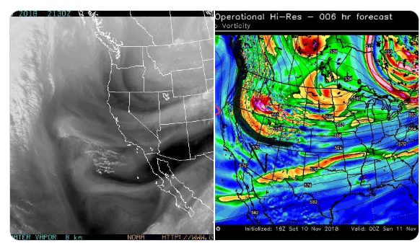
The Bigger the Fire – The “higher” the winds will come from
15,000 ft

